Slide 1
Olympics Analysis
By Mohd Wasi

Slide 2
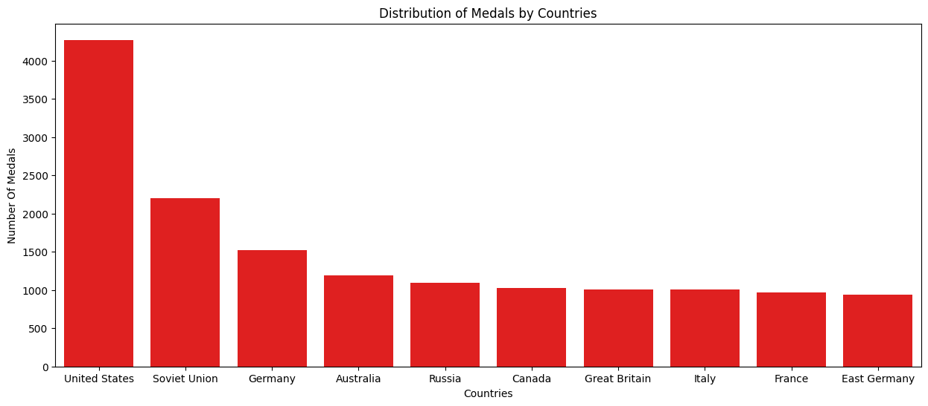
Visualizing the Medal Distribution Across Countries

Slide 3
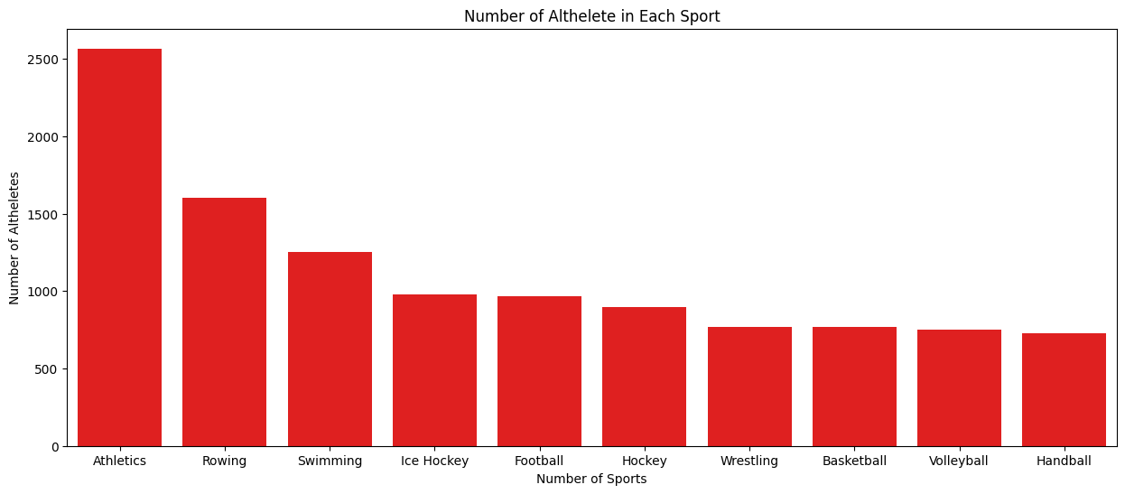
Visualizing Athlete Participation Across Different Sports

Slide 4
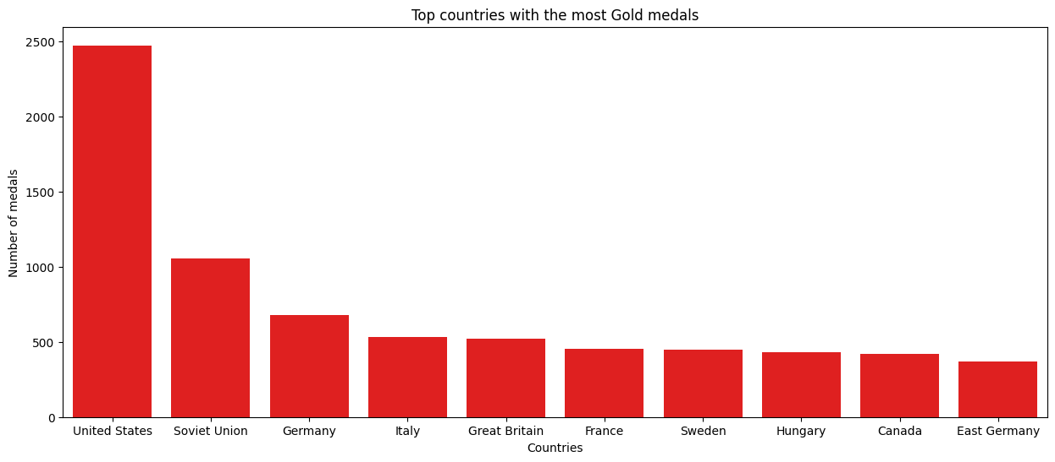
Visualizing the Top Countries with the Most Gold Medals

Slide 5
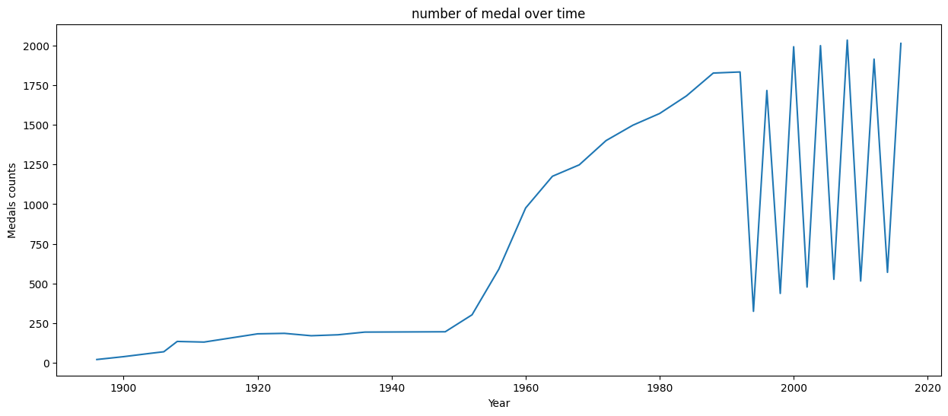
Trends in Medal Counts Over the Years

Slide 6
Aftermath Of Dataset
* United States Top with 4273 Medals,Soviet union,Germany and Australia,
Russia,Canada 2nd 3rd 4th 5th represently
* Athletics most playing Gaming In Olympics,Rowing, Swimming 2nd,3rd
* The barplot illustrates the number of athletes participating in each sport,
highlighting the sports with the highest and lowest levels of athlete involvement.
* US have dominated in achieving top podium finishes,Soviet union
and Germany 2dn, 3rd

Slide 7
After 1940 Number Of Medals Repidaly increase,sunddenly
Down Falls in 1999 Around
The line plot reveals the fluctuations in the number of medals awarded
over time, indicating significant peaks and troughs in various periods.
Generated by
Mohd Wasi

